Slide 1
House price analysis
Manan Dedhia
Amit Jadhav
Darshi Seth
Bhavesh Awalkar

Slide 2
Problem and Goal
Our goal for this project is to analyze how price of houses varied given various attributes that affect the value of a house.
We decided to choose a data set which contained details of house prices in Beijing.
Our primary focus was on utilising data analytics tools and algorithms to find patterns and correlations among various aspects that affect house prices.

Slide 3
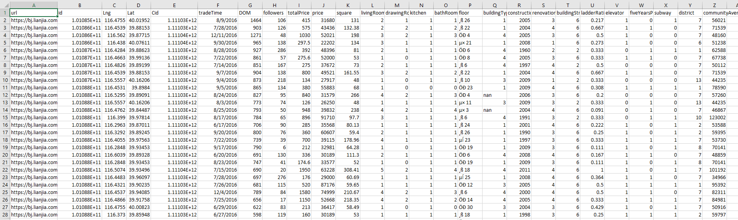
Data

Slide 4
Data Preparation and Preprocessing
The data set initially contained 26 columns and 318852 rows.
We removed unwanted rows like customerID, URL and trade time as it did not have any significant effect on our analysis.
We further proceeded with removing NAs.
To fit the model requirement, we converted the attributes from numeric and string to nominal form

Slide 5
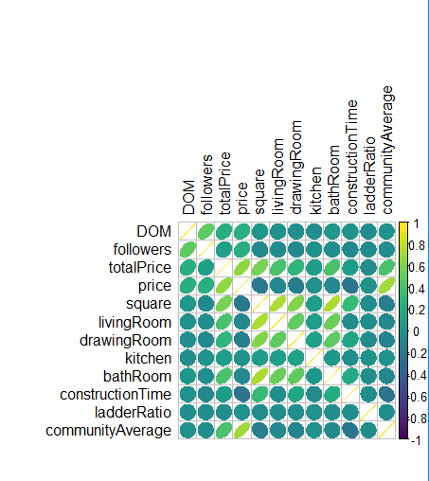
Descriptive Analysis

Slide 6
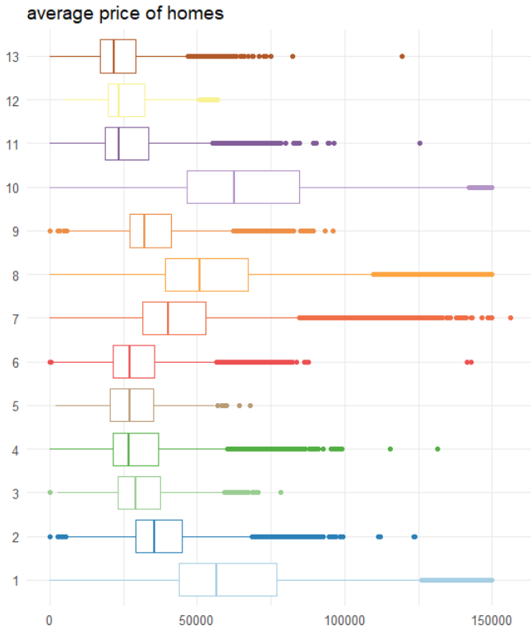
Average Price vs
District

Slide 7
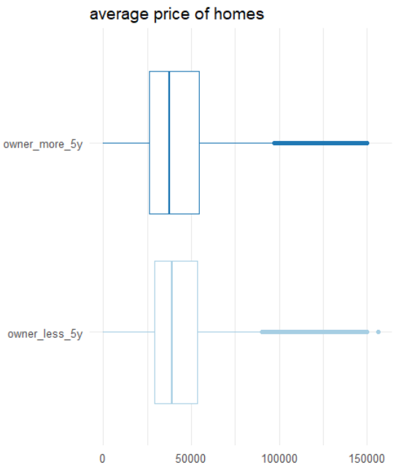
Average price vs

Slide 8
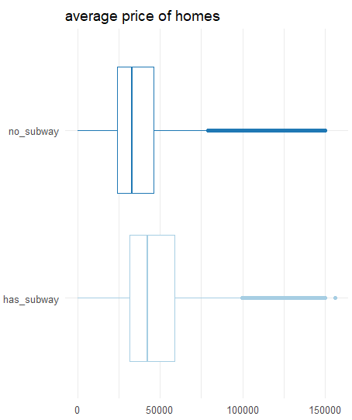
Average prices vs subway

Slide 9
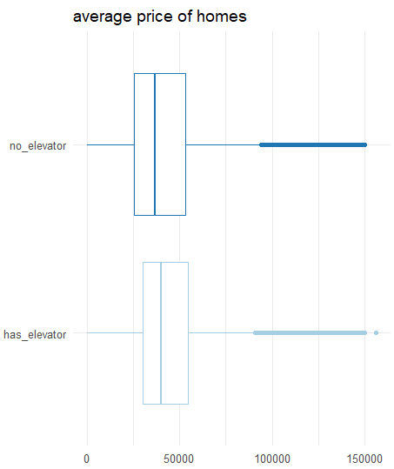
Average prices vs elevator

Slide 10
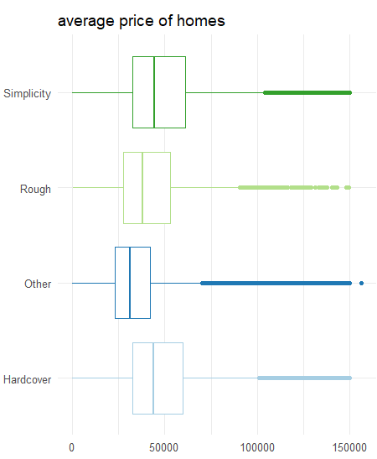
Average prices vs

Slide 11
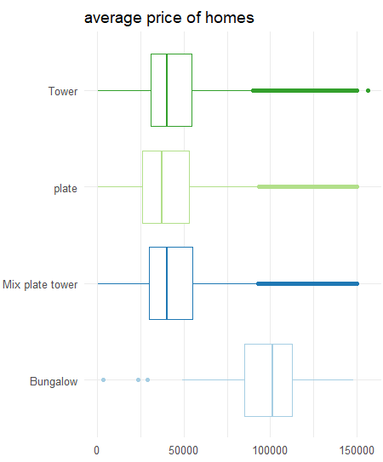
Average prices vs type of house

Slide 12
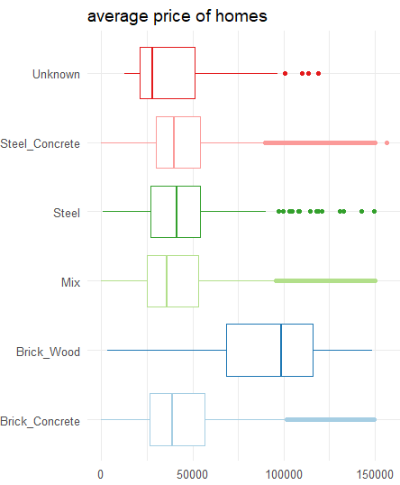
Average prices vs Material

Slide 13
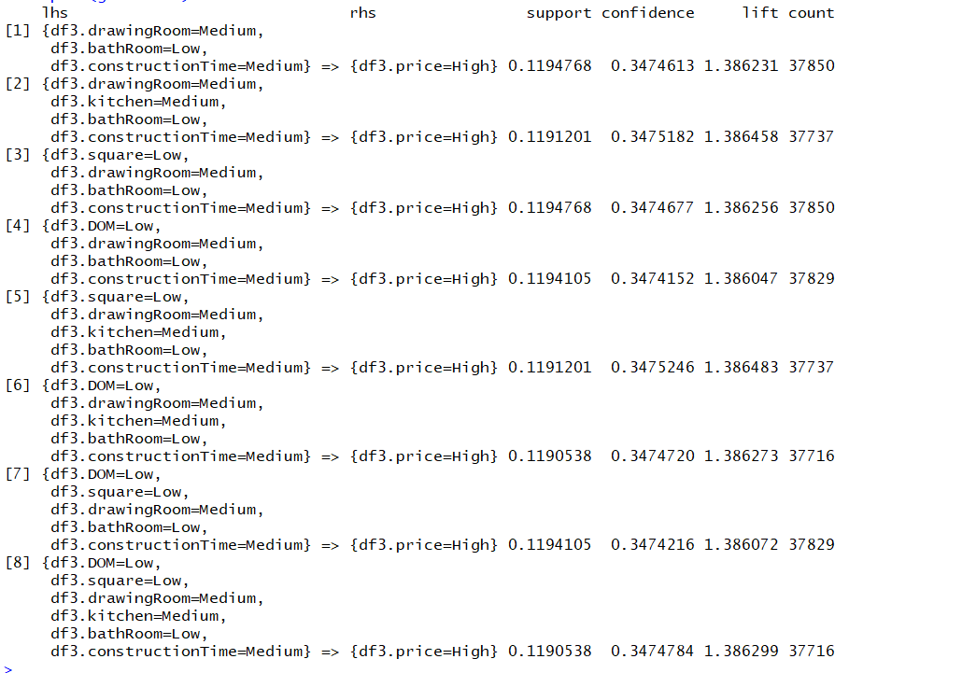
Apriori

Slide 14
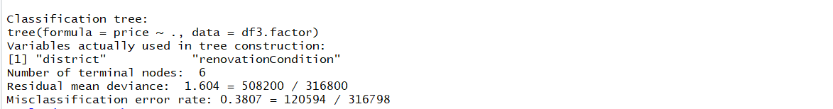
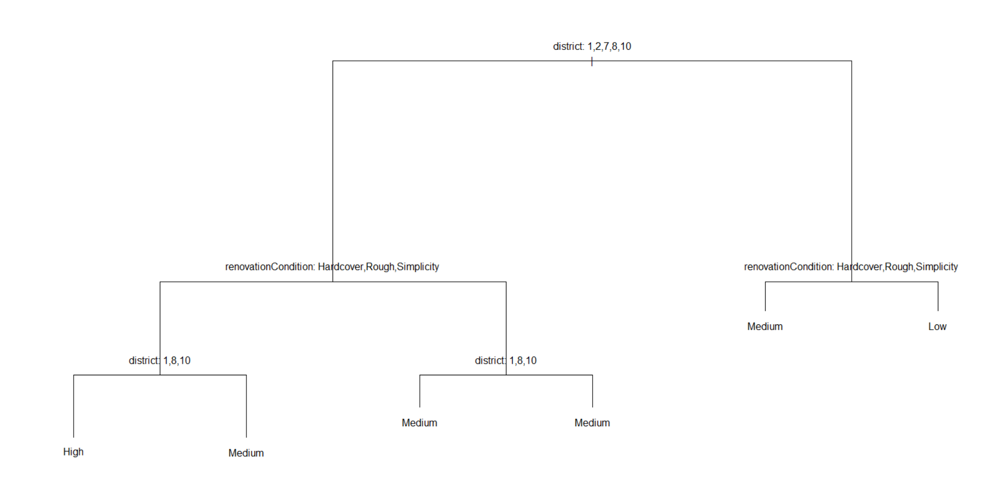
Decision tree

Slide 15
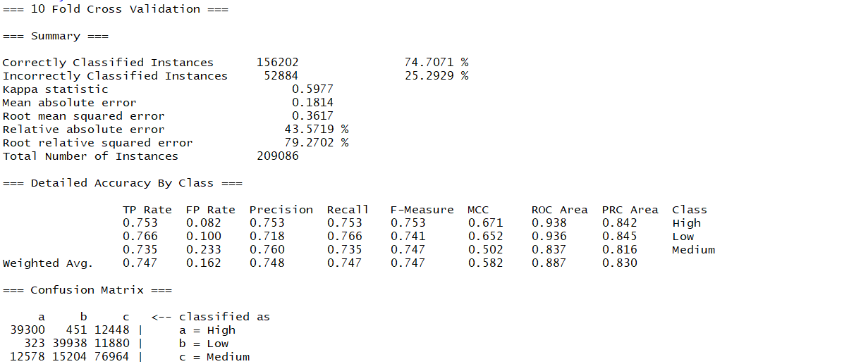
Naive Bayes

Slide 16
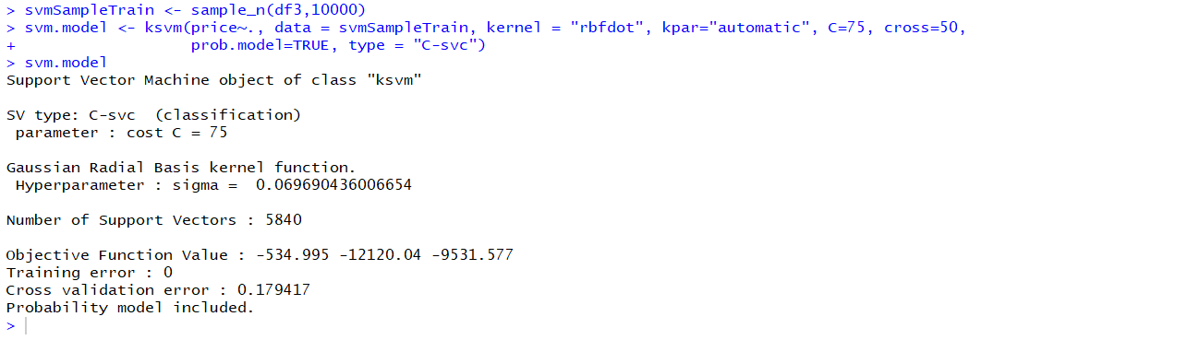
SVM

